Slide 1
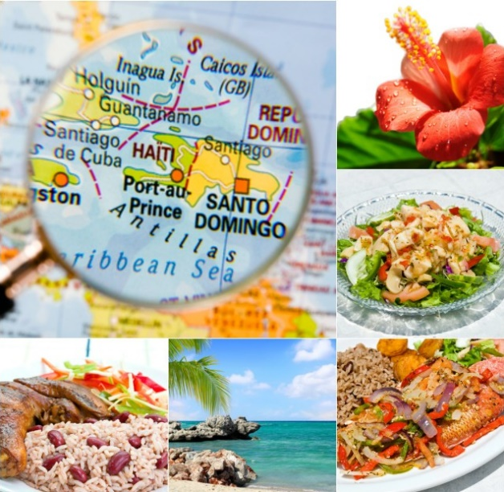
Exploring Caribbean Restaurants in New York City

Slide 2
Exploring Caribbean Restaurants in New York City
Do you know where you can get Caribbean cuisine in NYC?
The population consists of representatives of some 200 national groups, making it one of the most ethnically diverse cities in the world. Therefore, it is safe to say that the cuisine of New York City (NYC) comprises many cuisines belonging to the various ethnic groups.
Let’s explore…
Like New York City, the Caribbean Islands comprise people from the world over. The various waves of migration have formed a truly unique blend of cuisines and traditions in the region. The cultural confluence in Caribbean cuisine has turned the Caribbean islands into a food lovers’ paradise.

Slide 3
Exploring Caribbean Restaurants in New York City
Do you know where you can get Caribbean cuisine in NYC?
Data acquisition
New York Neighborhood Dataset- Link: https://cocl.us/new_york_dataset
Foursquare API - Link: https://enterprise.foursquare.com/products/places
Let’s explore…

Slide 4
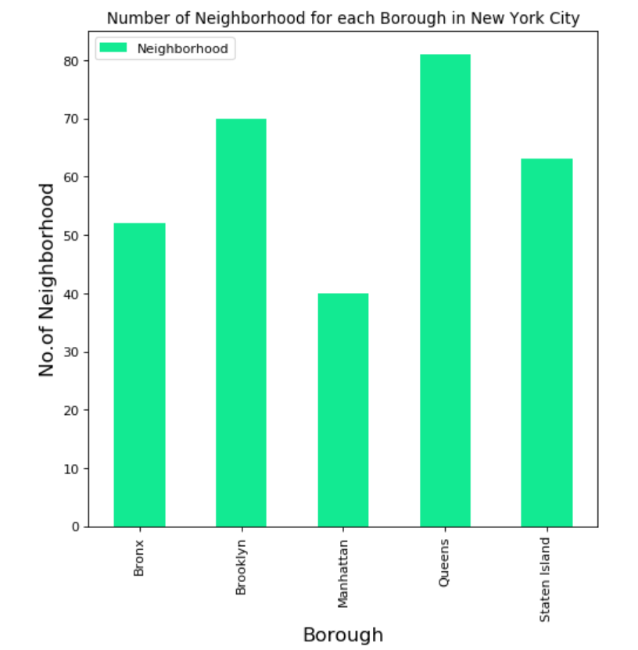
Exploring Caribbean Restaurants in New York City
Do you know where you can get Caribbean cuisine in NYC?
New York City consists of many neighborhoods scattered among the city’s five boroughs—Manhattan, Brooklyn, the Bronx, Queens, and Staten Island
Let’s explore…

Slide 5
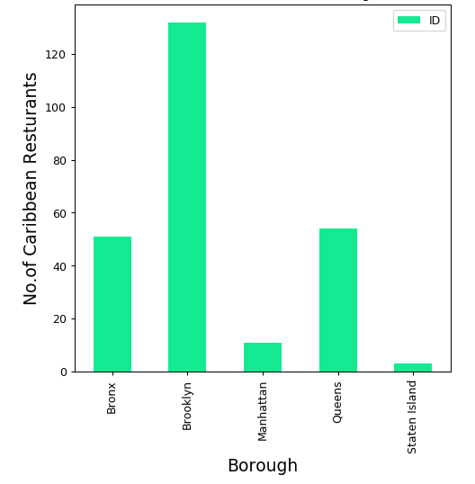
Exploring Caribbean Restaurants in New York City
Do you know where you can get Caribbean cuisine in NYC?
There are Caribbean restaurants in each borough.
Let’s explore…

Slide 6
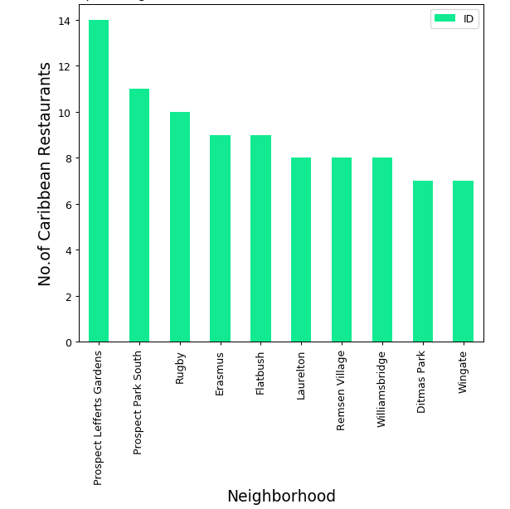
Exploring Caribbean Restaurants in New York City
Do you know where you can get Caribbean cuisine in NYC?
Within the boroughs, there are neighborhoods. Prospect Lefferts Gardens is the neighborhood with the most number of Caribbean restaurants.
Let’s explore…

Slide 7
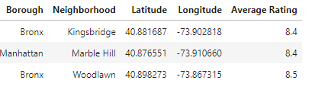
Exploring Caribbean Restaurants in New York City
Do you know where you can get Caribbean cuisine in NYC?
The Caribbean restaurants in Woodlawn, Bronx has the highest average rating. This is followed closely by the restaurants in Kingsbridge, Bronx and Marble Hill, Manhattan
Let’s explore…

Slide 8
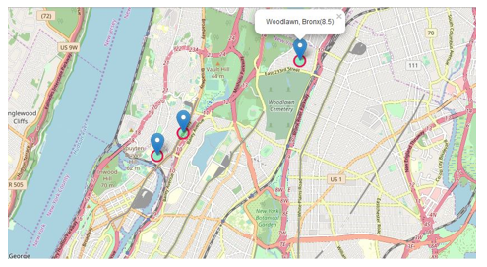
Exploring Caribbean Restaurants in New York City
Do you know where you can get Caribbean cuisine in NYC?
The Caribbean restaurants in Woodlawn, Bronx has the highest average rating. This is followed closely by the restaurants in Kingsbridge, Bronx and Marble Hill, Manhattan. Let’s visualize this on a map -
Let’s explore…

Slide 9
Exploring Caribbean Restaurants in New York City
Do you know where you can get Caribbean cuisine in NYC?
Conclusion
There are many Caribbean restaurants in New York City. Treat your taste buds: Explore New York City restaurants
Let’s explore…

